Slide 1
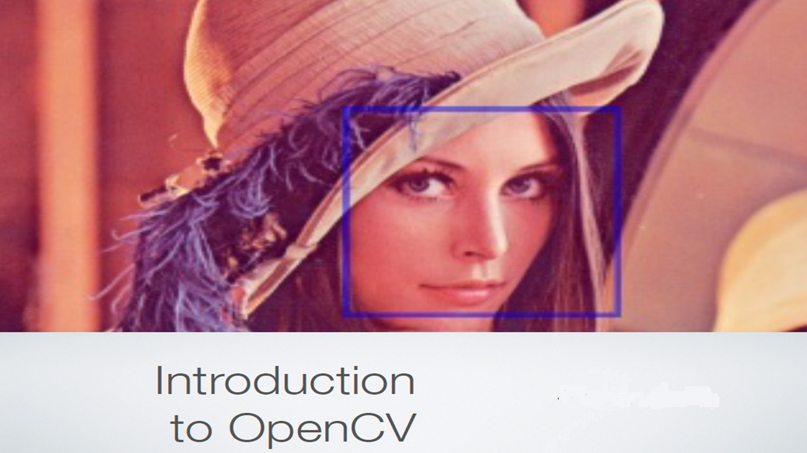
By NaveeN
Lena NaveeN

Slide 2
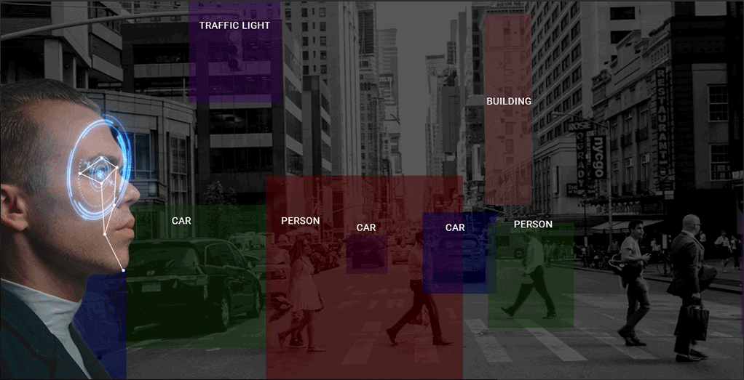


Slide 3
Computer vision is among the hottest fields in any industry right now.
OpenCV comes with a caveat,
it can be a daunting space for newcomers.
it can be a little tough to navigate for newcomers.
There are a plethora of functions available inside OpenCV, but it can become daunting to,
Understand the wide variety of functions available.
Gauge which function to use for your particular problem.

Slide 4
Presentation Contents
What is Computer Vision?
Why use OpenCV for Computer Vision Tasks?
Reading, Writing and Displaying Images
Changing Color Spaces
Resizing Images
Image Rotation
Image Translation
Simple Image Thresholding
Adaptive Thresholding
Image Segmentation (Watershed Algorithm)
Bitwise Operations
Edge Detection
Image Filtering
Image Contours
Scale Invariant Feature Transform (SIFT)
Speeded-Up Robust Features (SURF)
Feature Matching
Face Detection

Slide 5
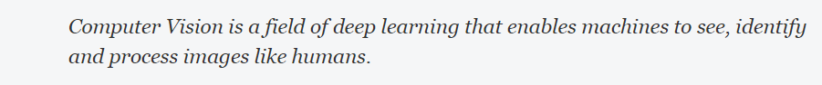
What is Computer Vision?
We use some of them everyday! Features like
unlocking our phones using face recognition
self-driving cars
computer vision is everywhere.
• Academic and Industry Research
• Security systems
• Google Maps, Street view
• Image/video search and retrieval
• Structure from motion in movies
• Machine vision factory production inspection systems
• Automatic Driver Assistance Systems
• Safety monitoring (Dam sites, mines, swimming pools)
• Robotics – personal, industrial, hobby
• Coin production in China
• Stitching street-view images together
• Detecting intrusions in surveillance video in Israel
• Detection of swimming pool drowning accidents in Europe
Human-Computer Interaction (HCI)
Object Identification
Object Recognition
Face Recognition
Gesture Recognition
Motion Tracking
Image Processing
Mobile Robotics
… and so on.

Slide 6
Overview
OpenCV, or Open Source Computer Vision library, started out as a research project at Intel(1999) & maintained by Willow Garage.
OpenCV contains implementations of more than 2500++ algorithms!
It is written natively in C++ .
BSD Licensed (free and open source)
It is freely available for commercial as well as academic purposes.
The library has interfaces for multiple languages, including C, C++, Python, Java, and Matlab.
Cross-platform [Linux & Windows] also available for Android and iOS .
No requirement to publish the source!
Must acknowledge OpenCV was used in the documentation by including its copyright.
You need not contribute back –But you are very welcome to contribute back!
Main sponsors : Intel, Google, MagicLeap & NVIDIA
OpenCV Corporation founded in July, 2012 http://opencv.org http://docs.opencv.org http://code.opencv.org
Note: There is a C#/.NET wrapper for OpenCV called “Emgu CV” that may be commercially licensed.
Note: A couple of algorithms (SIFT and SURF) that are implemented are patented.
– You can't accidentally use them because they are in a separate module called “nonfree”.

Slide 7
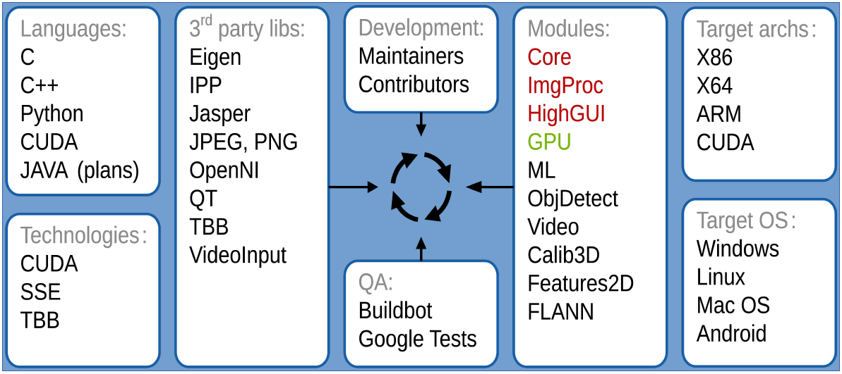
OpenCV Architecture and Development

Slide 9
OpenCV Hardware Acceleration
OpenCV was a central basis for OpenVX
a hardware abstraction layer
for embedded vision acceleration

Slide 11
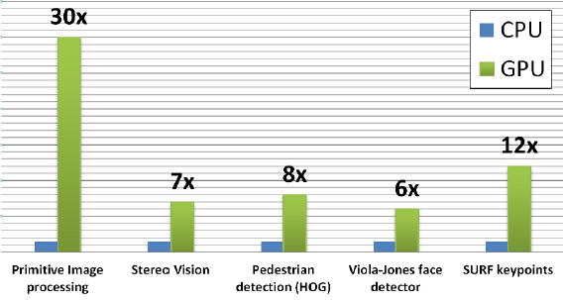

Slide 12
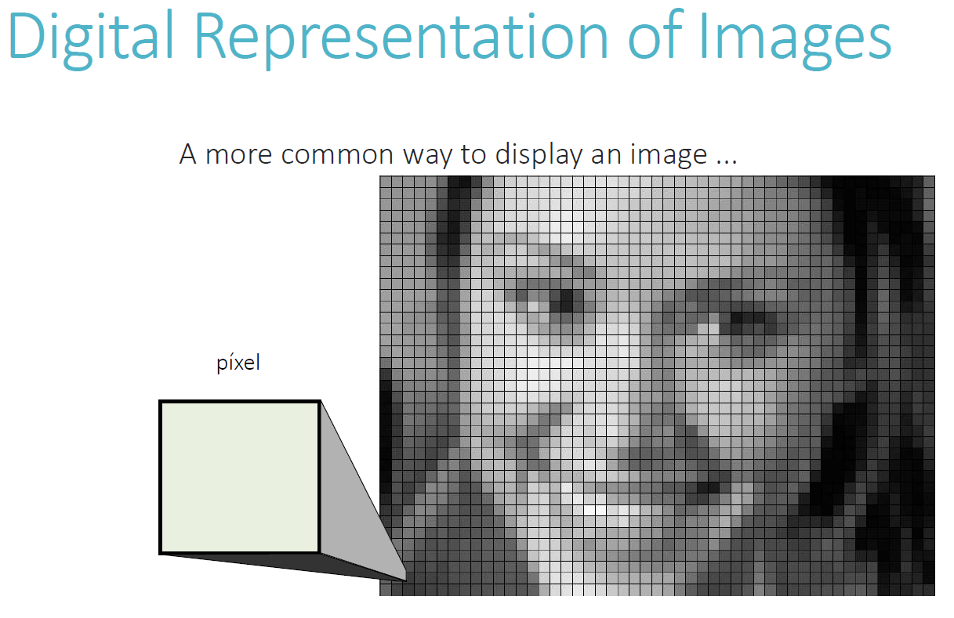
A digital image is a matrix or two-dimensional array of numbers.
Each cell in the matrix represents a pixel.

Slide 14
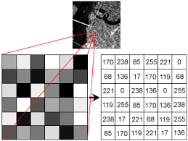
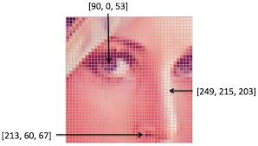
How do you convert images to numbers ? Two words – pixel values.
Every number represents the pixel intensity at that particular location.
A grayscale image where every pixel contains only one value i.e. the intensity of the black color at that location.
A color images will have multiple values for a single pixel. These values represent the intensity of respective channels – Red, Green and Blue channels for RGB images
Two words – pixel values

Slide 15
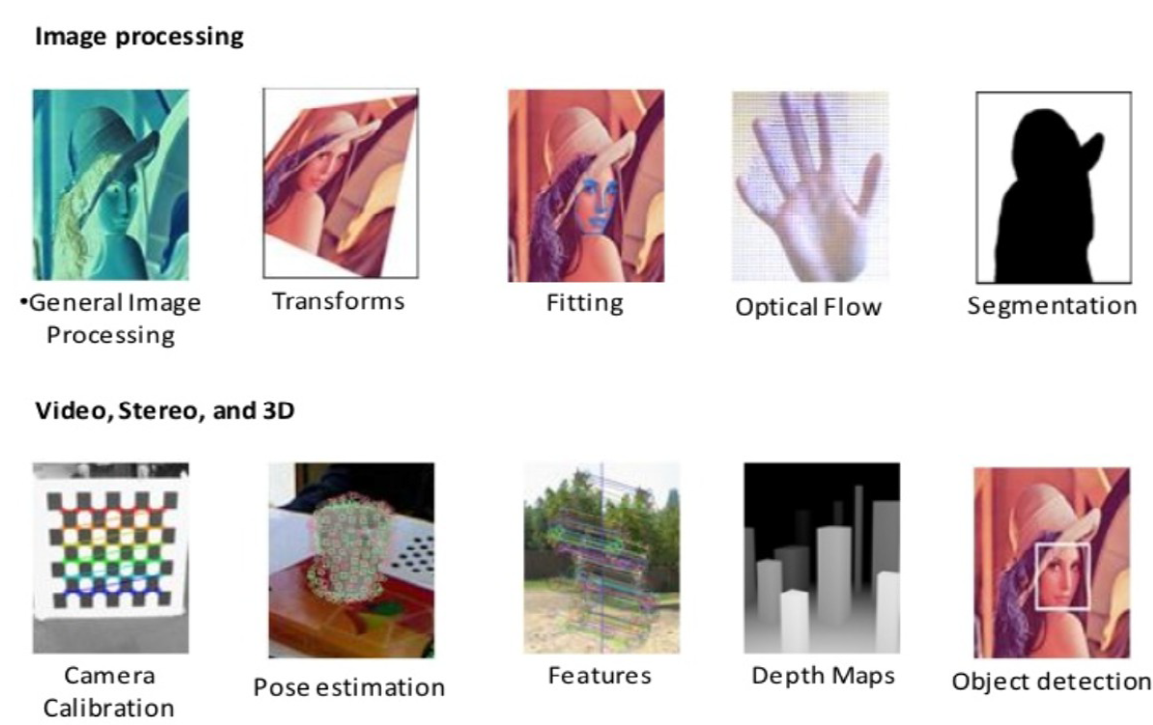
Why use OpenCV for Computer Vision Tasks?

Slide 16
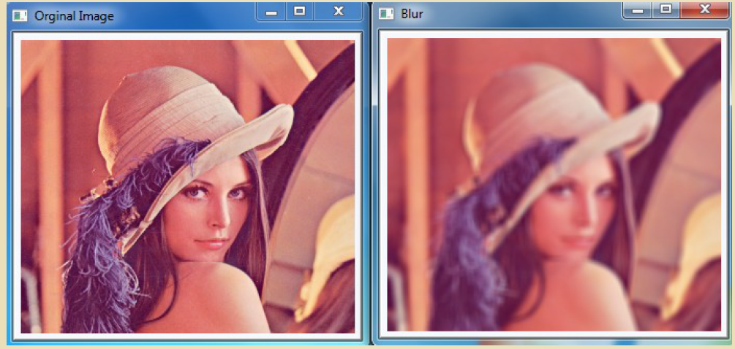
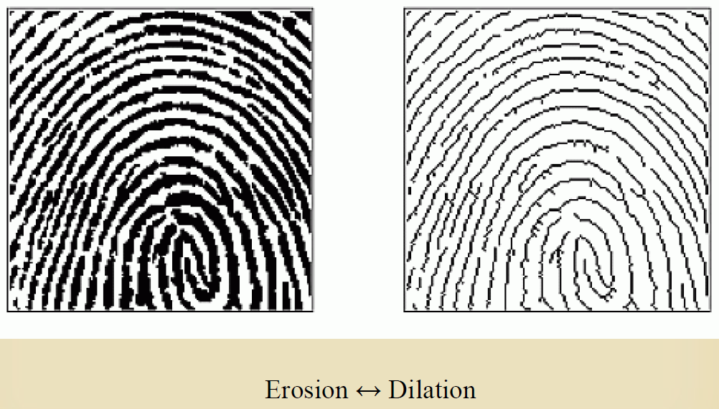
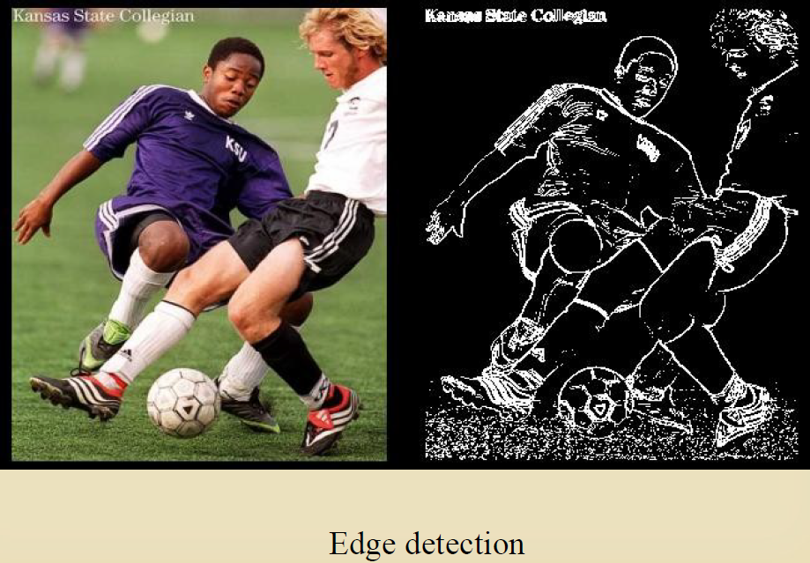
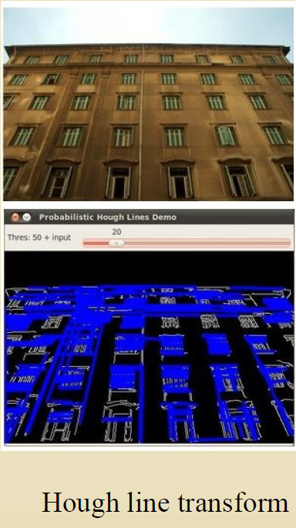
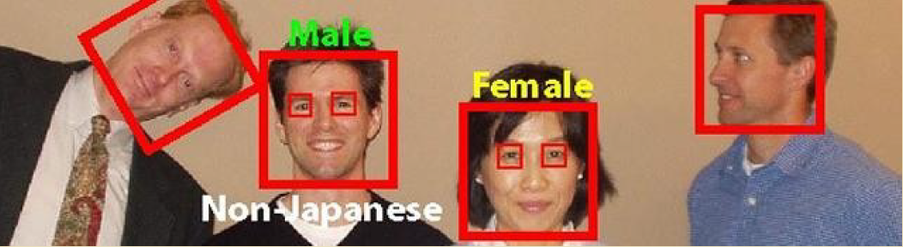

Slide 17
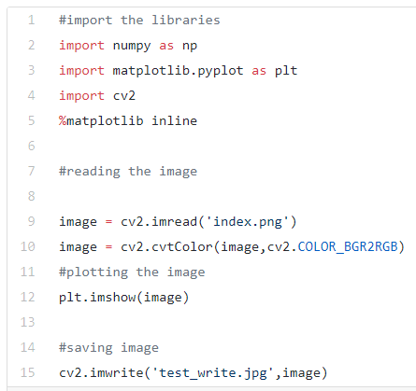
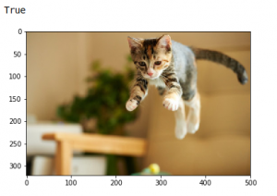
Reading, Writing and Displaying Images
1-readWrite.ipynb
By default, the imread function reads images in the BGR (Blue-Green-Red) format.
We can read images in different formats using extra flags in the imread function:
cv2.IMREAD_COLOR: Default flag for loading a color image
cv2.IMREAD_GRAYSCALE: Loads images in grayscale format
cv2.IMREAD_UNCHANGED: Loads images in their given format, including the alpha channel. Alpha channel stores the transparency information – the higher the value of alpha channel, the more opaque is the pixel

Slide 18
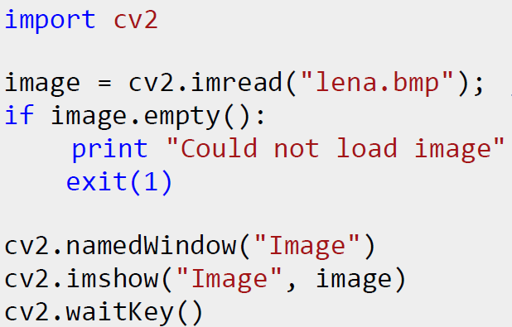
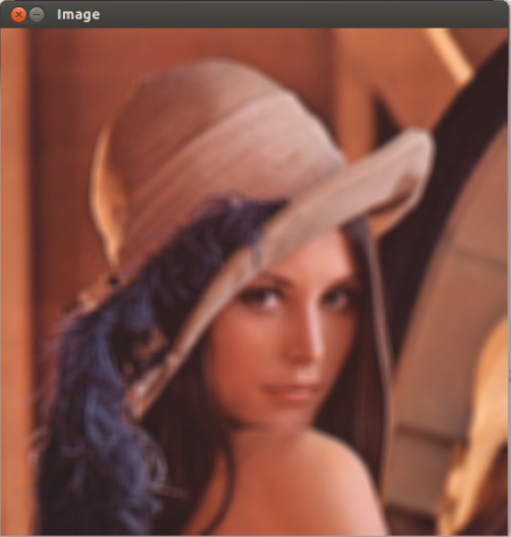

Slide 19
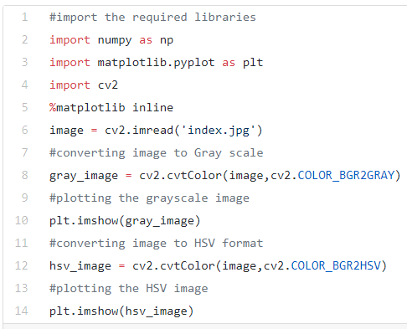
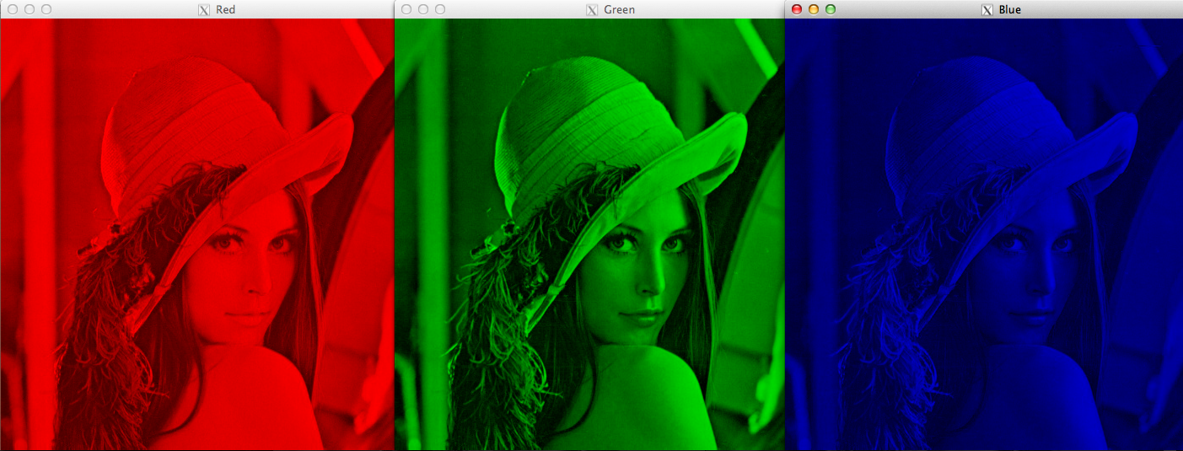
Changing Color Spaces
3-ChangingColorSpaces.ipynb
A color space is a protocol for representing colors in a way that makes them easily reproducible.
Most computer vision use cases process images in RGB format.
However, applications like video compression and device independent storage – these are heavily dependent on other color spaces, like the Hue-Saturation-Value or HSV color space.
The intensity information and color information are mixed in RGB color space
but in HSV color space the color information and intensity information are separated from each other. This makes HSV color space more robust to lighting changes.

Slide 20
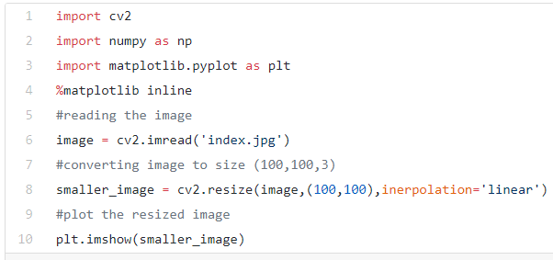
Resizing Images
4-ResizingImages.ipynb
Machine learning models work with a fixed sized input. The same idea applies to computer vision models as well. The images we use for training our model must be of the same size.
Images can be easily scaled up and down using OpenCV. This operation is useful for training deep learning models when we need to convert images to the model’s input shape.
Different interpolation and downsampling methods are supported by OpenCV, which can be used by the following parameters:
INTER_NEAREST: Nearest neighbor interpolation
INTER_LINEAR: Bilinear interpolation
INTER_AREA: Resampling using pixel area relation
INTER_CUBIC: Bicubic interpolation over 4×4 pixel neighborhood
INTER_LANCZOS4: Lanczos interpolation over 8×8 neighborhood

Slide 21
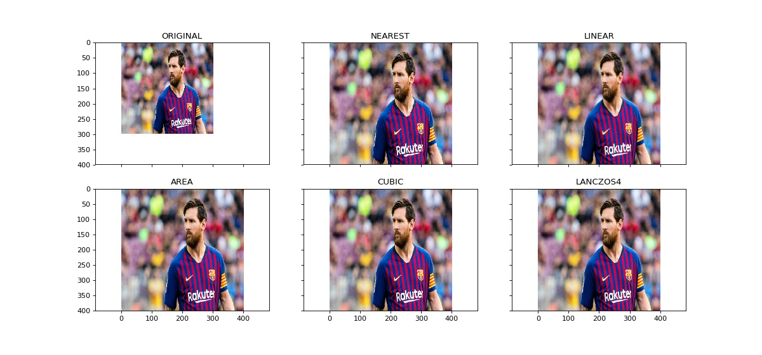

Slide 22
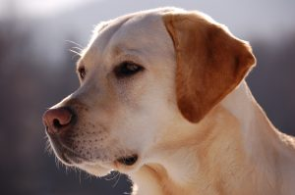
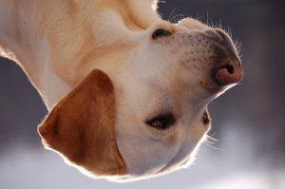
Image Rotation
5-ImageRotation.ipynb
“You need a large amount of data to train a deep learning model”, It’s partially true – most deep learning algorithms are heavily dependent on the quality and quantity of the data.
Not all of us can afford to manually collect and label images.
Ex: building an image classification model for identifying the animal present in an image. So, both the images shown below should be classified as ‘dog’:
But the model might find it difficult to classify the second image as a Dog if it was not trained on such images. So what should we do?
Let me introduce you to the technique of data augmentation. This method allows us to generate more samples for training our deep learning model.
Data augmentation uses the available data samples to produce the new ones, by applying image operations like rotation, scaling, translation, etc. This makes our model robust to changes in input and leads to better generalization.
Rotation is one of the most used and easy to implement data augmentation techniques.
As the name suggests, it involves rotating the image at an arbitrary angle and providing it the same label as the original image.

Slide 23
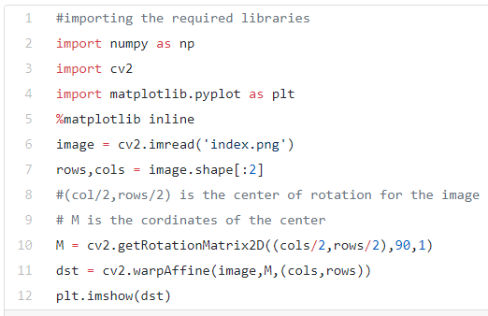
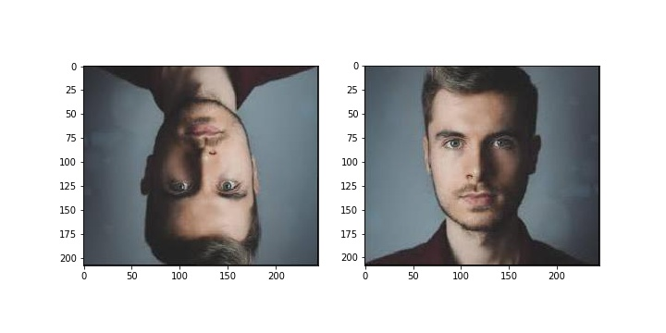

Slide 24
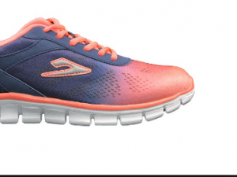
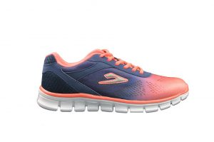
Image Translation
6-ImageTranslation.ipynb
Image translation is a geometric transformation that maps the position of every object in the image to a new location in the final output image.
After the translation operation, an object present at location (x,y) in the input image is shifted to a new position (X,Y):
X = x + dx
Y = y + dy
Image translation can be used to add shift invariance to the model
This augmentation technique can also help the model correctly classify images with partially visible objects.

Slide 25
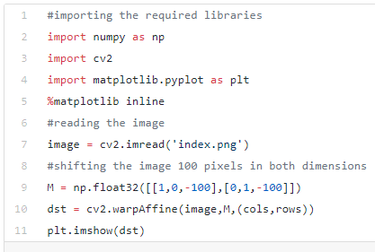
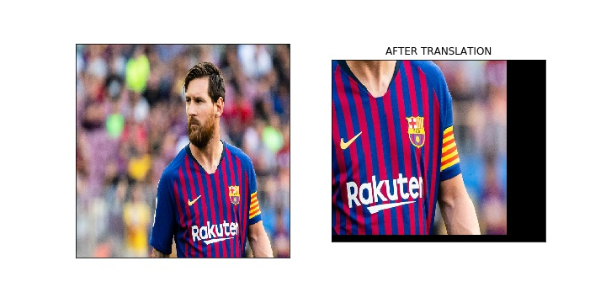

Slide 26
Simple Image Thresholding
7-SimpleImageThresholding.ipynb
Thresholding is an image segmentation method, compares pixel values with a threshold value.
if Image(x,y) > threshold
Image(x,y) = 1
Otherswise
Image(x,y) = 0
Thresholding can only be applied to grayscale images.
Image segmentation is the task of classifying every pixel in the image to some class.
For example, classifying every pixel as foreground or background.
Image segmentation is important for extracting the relevant parts from an image.

Slide 27
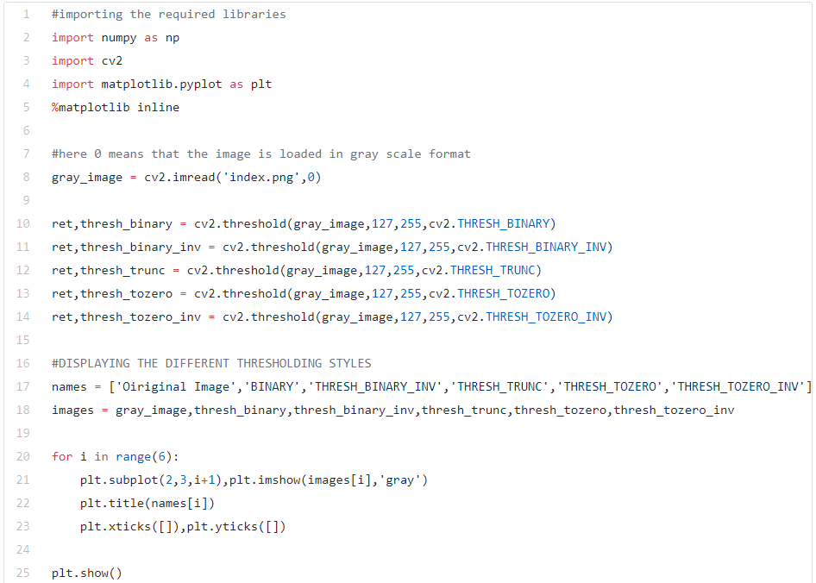
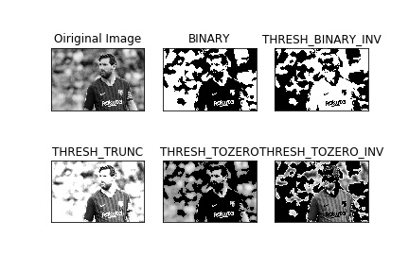

Slide 28
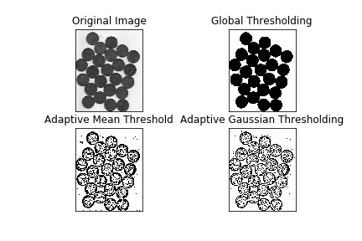
Adaptive Thresholding
8-AdaptiveThresholding.ipynb
Different threshold values are used for different parts of the image.
This function gives better results for images with varying lighting conditions – hence the term “adaptive”.
“Otsu’s binarization method” finds an optimal threshold value for the whole image.
It works well for bi-modal images (images with 2 peaks in their histogram)
Coins on desk, is an good example right ?

Slide 29
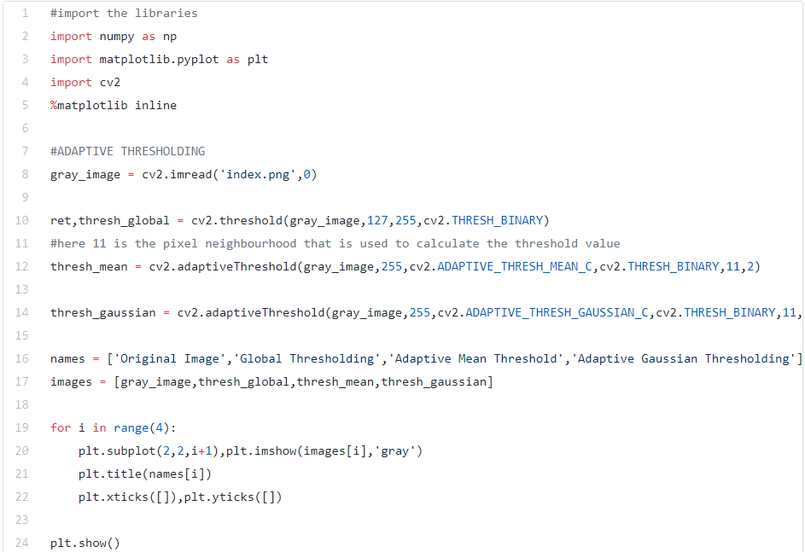

Slide 30
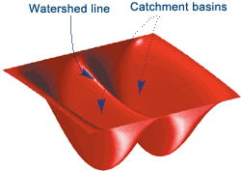
Image Segmentation (Watershed Algorithm)
9-ImageSegmentation.ipynb
The watershed algorithm is a classic image segmentation algorithm.
It considers the pixel values in an image as topography.
For finding the object boundaries, it takes initial markers as input.
The algorithm then starts flooding the basin from the markers till the markers meet at the object boundaries.
Let’s say we have a topography with multiple basins. Now, if we fill different basins with water of different color, then the intersection of different colors will give us the object boundaries.
This is the intuition behind the watershed algorithm.

Slide 31
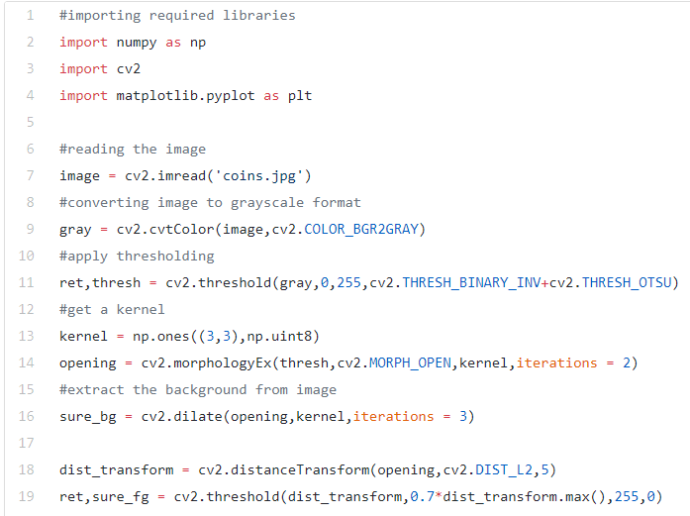
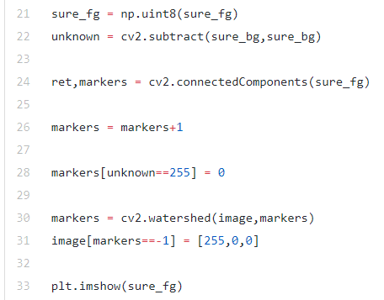

Slide 32
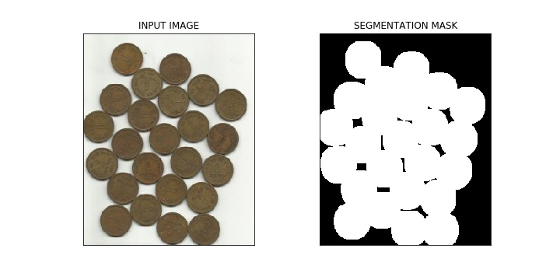

Slide 33
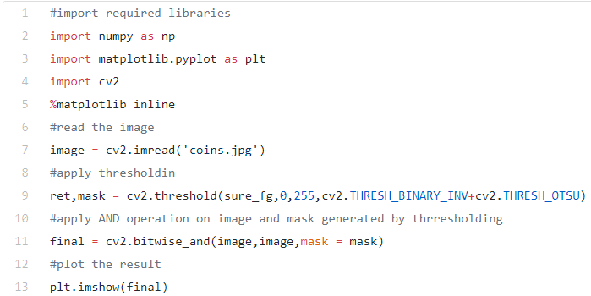
Bitwise Operations
10-BitwiseOperators.ipynb
Bitwise operations include AND, OR, NOT and XOR. You might remember them from your programming class!
In computer vision, these operations are very useful when we have a mask image and want to apply that mask over another image to extract the region of interest.

Slide 34
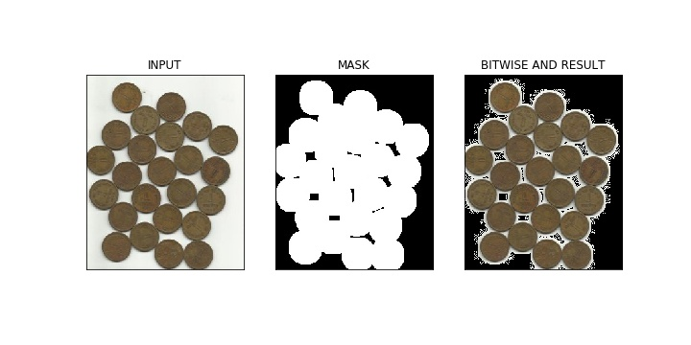
In the above figure, we can see an input image and its segmentation mask calculated using the Watershed algorithm.
Further, we have applied the bitwise ‘AND’ operation to remove the background from the image and extract relevant portions from the image.
Pretty awesome stuff!.

Slide 35
Edge Detection
11-EdgeDetection.ipynb
Edges are the points in an image where the image brightness changes sharply or has discontinuities.
Such discontinuities generally correspond to:
Discontinuities in depth
Discontinuities in surface orientation
Changes in material properties
Variations in scene illumination
Edges are very useful features of an image that can be used for different applications like classification of images in the object and localization.
Even deep learning models calculate edge features to extract information about the objects present in image.
Edges are different from contours as they are not related to objects rather they signify the changes in pixel values of an image.
Edge detection can be used for image segmentation and even for image sharpening.

Slide 36
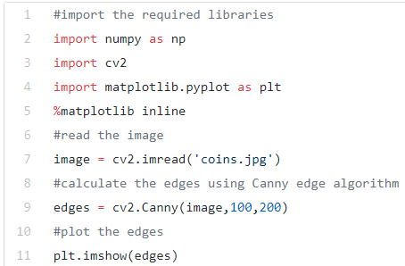
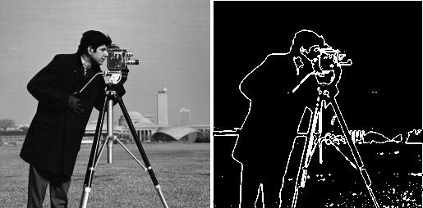

Slide 37
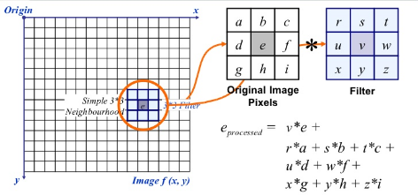
Image Filtering
12-ImageFiltering.ipynb
In image filtering, a pixel value is updated using its neighbouring values.
HOW ?
Well, there are multiple ways of updating pixel values, such as selecting the maximum value from neighbours, using the average of neighbours, etc.
Each method has it’s own uses. For example,
Averaging the pixel values in a neighbourhood is used for image blurring.
Gaussian filtering is also used for image blurring that gives different weights to the neighbouring pixels based on their distance from the pixel under consideration.

Slide 38
For image filtering, we use kernels.
Kernels are matrices of numbers of different shapes like 3 x 3, 5 x 5, etc.
A kernel is used to calculate the dot product with a part of the image. When calculating the new value of a pixel, the kernel center is overlapped with the pixel.
The neighbouring pixel values are multiplied with the corresponding values in the kernel.
The calculated value is assigned to the pixel coinciding with the center of the kernel.

Slide 39
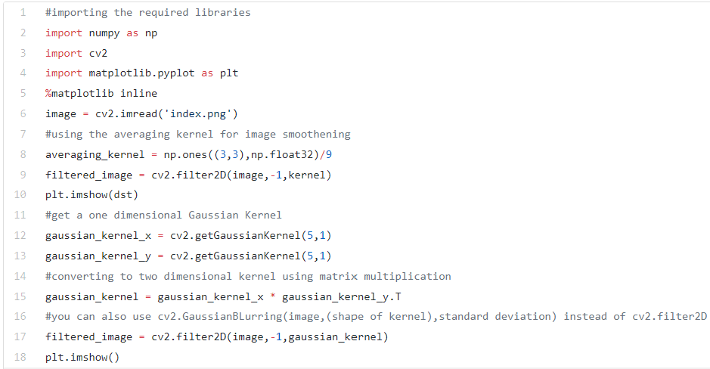

Slide 40
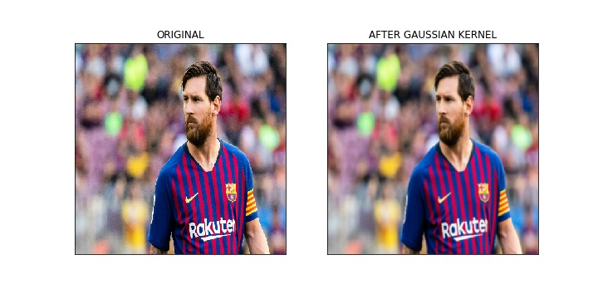
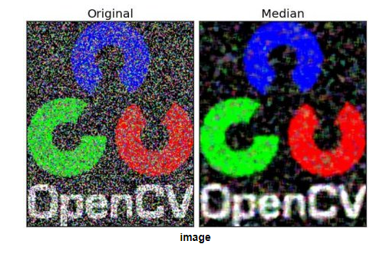
In the above output,
The image on the right shows the result of applying Gaussian kernels on an input image.
We can see that the edges of the original image are suppressed.
The Gaussian kernel with different values of sigma is used extensively to calculate the Difference of Gaussian for our image.
This is an important step in the feature extraction process because it reduces the noise present in the image.

Slide 41
Image Contours
13-Image-Contours.ipynb
A contour is a closed curve of points or line segments that represents the boundaries of an object in the image.
Contours are essentially the shapes of objects in an image
Contours are not part of an image. Instead, they are an abstract collection of points and line segments corresponding to the shapes of the object(s) in the image.
We can use contours
To count the number of objects in an image
To categorize objects on the basis of their shapes
or
select objects of particular shapes from the image.

Slide 42
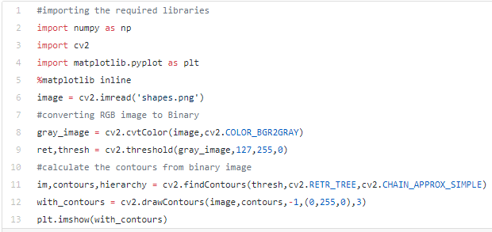
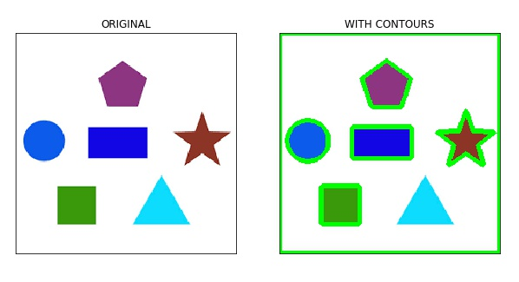

Slide 43
Scale Invariant Feature Transform (SIFT)
14-SIFT.ipynb
Keypoints is a concept you should be aware of when working with images.
These are basically the points of interest in an image.
Keypoints are analogous to the features of a given image.
They are locations that define what is interesting in the image.
Keypoints are important, because no matter how the image is modified (rotation, shrinking, expanding, distortion), we will always find the same keypoints for the image.
Scale Invariant Feature Transform (SIFT) is a very popular keypoint detection algorithm.
It consists of the following steps:
Scale-space extrema detection
Keypoint localization
Orientation assignment
Keypoint descriptor
Keypoint matching
Features extracted from SIFT can be used for applications like image stitching, object detection

Slide 44
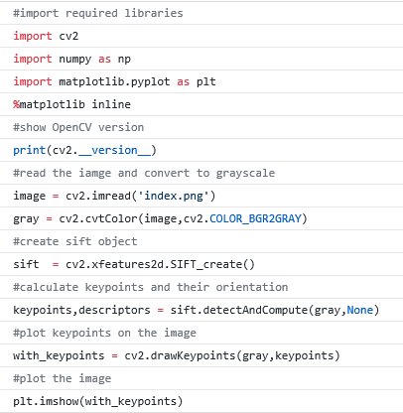
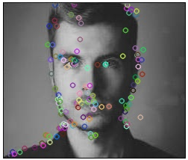

Slide 45
Speeded-Up Robust Features (SURF)
15-SURF.ipynb
Speeded-Up Robust Features (SURF) is an enhanced version of SIFT. It works much faster and is more robust to image transformations.
In SURF, the scale space is approximated using Laplacian of Gaussian
Laplacian is a kernel used for calculating the edges in an image. The Laplacian kernel works by approximating a second derivative of the image. Hence, it is very sensitive to noise.
We generally apply the Gaussian kernel to the image before Laplacian kernel thus giving it the name Laplacian of Gaussian.

Slide 46



Slide 47

Feature Matching
The features extracted from different images using SIFT or SURF can be matched to find similar objects/patterns present in different images.
The OpenCV library supports multiple feature-matching algorithms, like
brute force matching,
knn feature matching, among others.

Slide 48

we can see that the keypoints extracted from the original image (on the left) are matched to keypoints of its rotated version.
This is because the features were extracted using SIFT, which is invariant to such transformations.

Slide 49
Face Detection
OpenCV supports haar cascade based object detection. Haar cascades are machine learning based classifiers that calculate different features like edges, lines, etc in the image. Then, these classifiers train using multiple positive and negative samples.
Trained classifiers for different objects like faces,eyes etc are available in the OpenCV Github repo , you can also train your own haar cascade for any object.

Slide 50



